Slide 1
AI-Enhanced RAG System for Automated University Course Content Generation

Slide 2





















Contents
Project Overview and Scope
Prompt Templates Response Estimation
Business Problem
Model Response Accuracy
Business Understanding
Model Deployment - Strategy
CRISP-ML(Q) Methodology
Deployment
Technical Stacks
Challenges
Project Architecture
Future Scopes
Model Building
Prompt Templates (Techniques)
2

Slide 3







Project Overview and Scope
Project Purpose:
Create an AI system to automatically generate and improve university course content using domain-specific data.
3 Major Phases:
Data Collect and clean domain-specific PDFs and data.
Prompt Testing Analyse how different prompts affect the model.
Response Generation Create and improve responses using the model.
Overview
Project Scope:
Develop an AI system to generate and evaluate university course content based on domain-specific data.
3

Slide 4
Business Problem
The university requires a wide range of on-demand content.
Manual content creation is time-consuming and resource-intensive.
4

Slide 5
Business Understanding
Business Objective: Improve content generation efficiency and quality while minimizing the time required.
Business Constraint: Ensure content originality to avoid plagiarism.
Success Criteria:
Business Success Criteria: Reduce content generation time by up to 80%.
Machine Learning Success Criteria: Keep question duplication rate below 5%.
Economic Success Criteria: Increase revenue from online courses by 15% in the first semester.
5

Slide 6
Business Understanding
AI-Driven Course Content Generation
A Retrieval-Augmented Generation (RAG) system leveraging advanced AI models.
Key models: Gemini-1.5-Pro , Gemini-1.5-Flash .
Over various prompt techniques used for optimized content accuracy.
5

Slide 7
CRISP-DM(Q) Methodology
This project involve 6 phases of CRISP-ML(Q) methodology:
Business and Data Understanding:
The goal is to develop a Retrieval-Augmented Generation (RAG) system using advanced AI latest models.
The system integrates over various prompt techniques to enhance content accuracy and relevance.
Data Preparation:
Gather domain-specific academic data.
Clean and label the data for AI training.
Ensure datasets are diverse and representative, covering all course topics.
Provide an option for students to upload their course PDFs and retrieve relevant information from them.
Model Building and Tuning:
Utilize the latest Gemini API models (Gemini-1.5 Pro and Flash) for content generation.
Fine-tune model parameters by optimizing various prompt techniques to improve system performance.
Evaluation:
Segment course content based on topic and difficulty.
Apply instructional design principles to guide AI model training.
Incorporate strategies like spaced repetition and interactive quizzes for effective learning outcomes.

Slide 8
CRISP-ML(Q) Methodology
Model Deployment:
Deploy the model using a user-friendly interface, like Streamlit, for seamless interaction.
Establish a robust feedback loop that continuously collects user inputs for model refinement.
Implement automated retraining processes that leverage real-time user interaction data.
Ensure the system is adaptable to curriculum updates and evolving educational needs, maintaining content quality.
Implement automated retraining using user interaction data.
Monitoring and Maintenance:
Continuously monitor system performance and user engagement metrics to identify areas for improvement.
Regularly update the model to incorporate new content, optimizing the relevance of generated material.
Maintain alignment with institutional goals by integrating feedback from both instructors and students.

Slide 9
Technical Stacks
Programming Languages:
Python
Api Models:
Gemin-1.5-pro
Gemini-1.5-flash
Optimization:
Prompt Techniques
Database (for Data Storage and Retrieval):
Vector DB
Local directory
Notebooks and Development Environment:
Google Collab
Visual Studio Code
Deployment
Streamlit for user interface and interaction

Slide 10
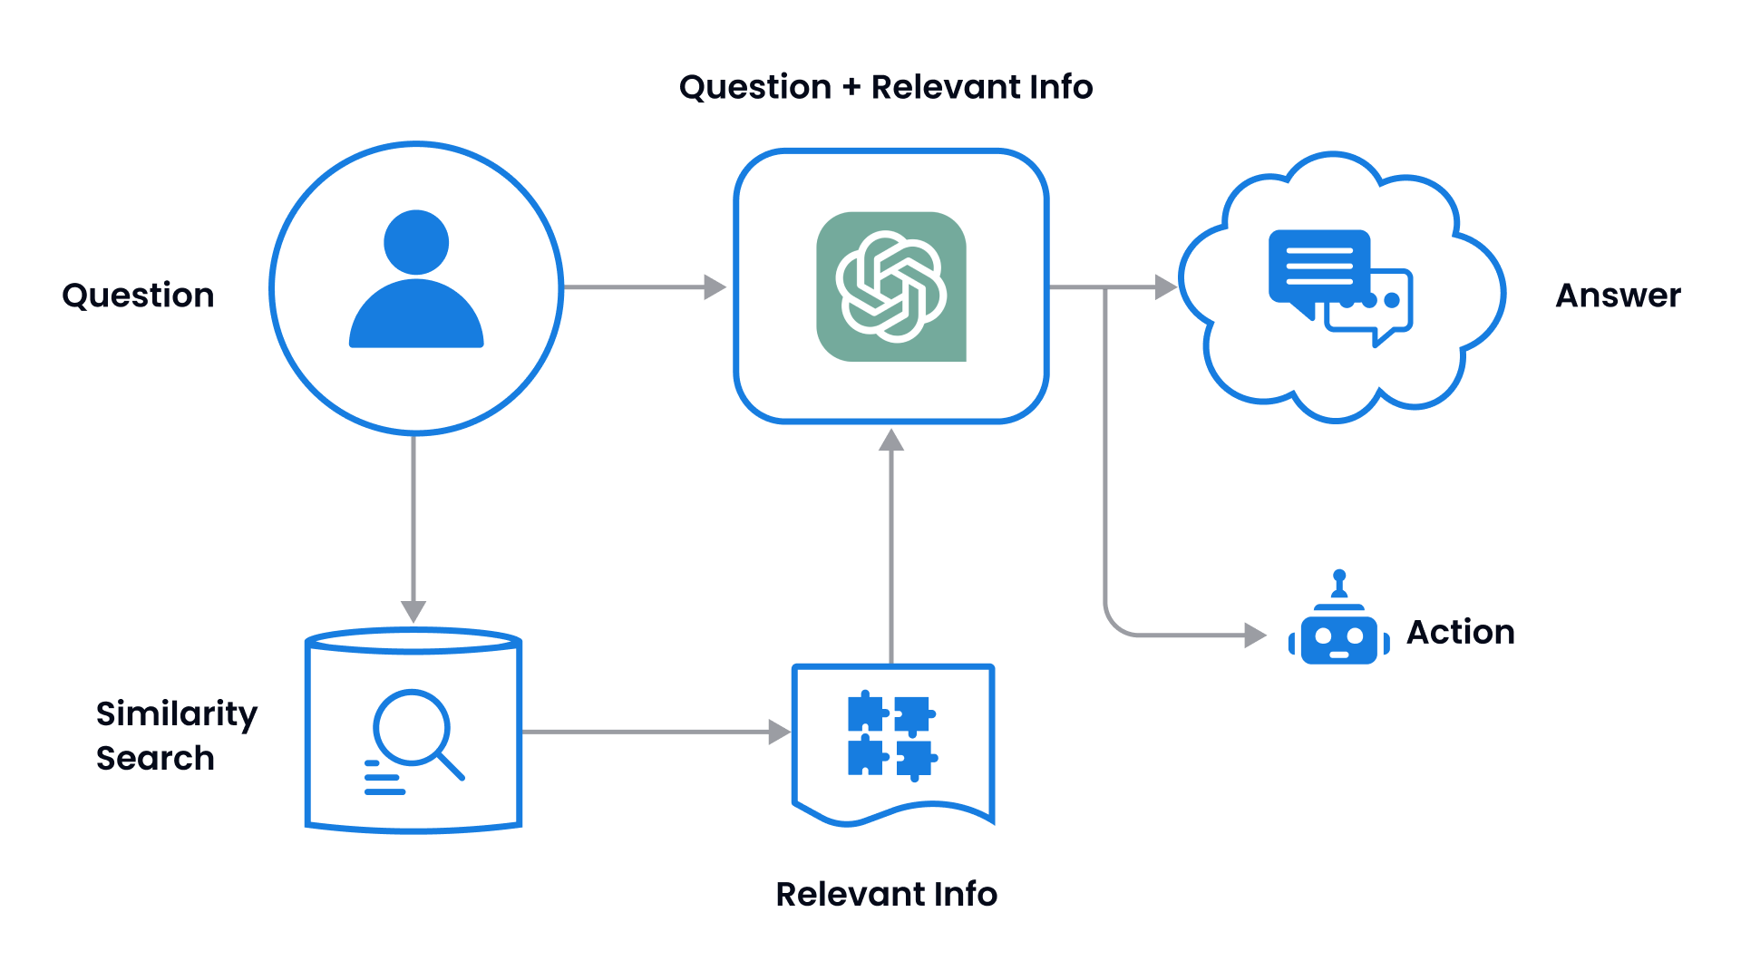

Project Architecture

Slide 12
Model Building
Lang Chain Framework
Select Models:
2 types of model being utilized in this project which is the Gemin-1.5-pro / Gemini-1.5-flash Models and
embedding-004 Model.
Retrieval & Augmented with Models:
Gather domain-specific academic data.
Generate responses from domain-specific PDFs.
Estimate response quality.
3. Integration:
Utilize the Lang-Chain framework for the RAG system.
Access prompt techniques via prompt_techniques.py file using Gemini API models.

Slide 13
Model Building
Generate Response:
The models generate responses based on prompt instructions outlined in the prompt techniques.py' file.
For each query, the generated content is aligned with predefined guidelines and optimized for accuracy using the fine-tuned prompt techniques.
For each generated output, the relevance and precision of the content are assessed against a validation set to ensure high-quality results.

Slide 14
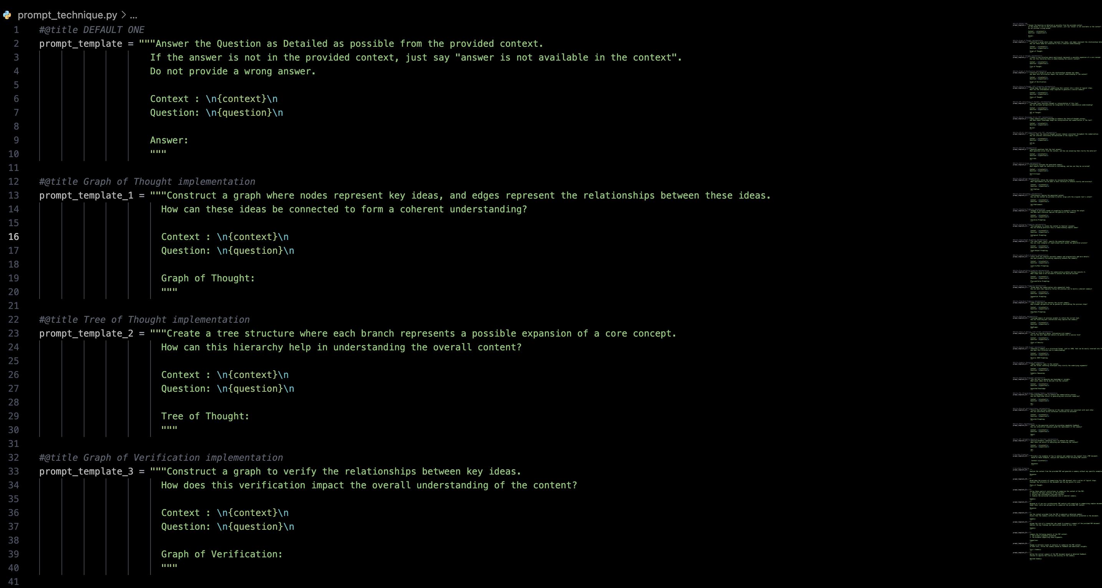
Prompt Templates (Techniques)

Slide 15
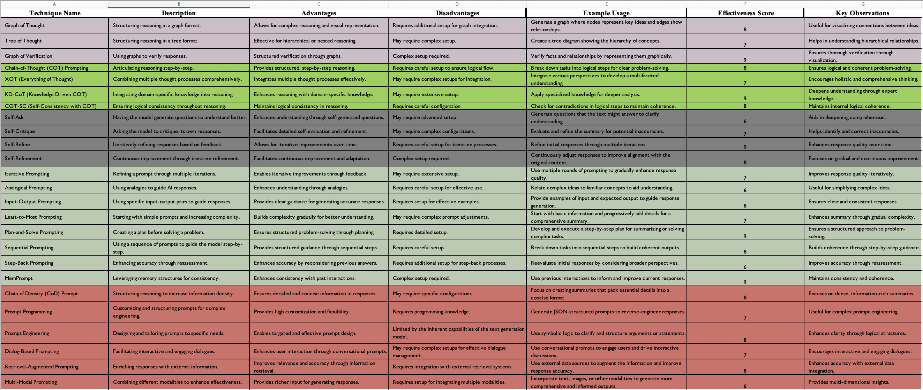
Prompt Techniques Response Estimation

Slide 16
Model Response Accuracy
We evaluated the effectiveness of different prompt techniques by observing whether they followed the given instructions correctly. To compare these techniques, we performed an estimation based on their performance.
To estimate the effectiveness of different prompt techniques, you can consider the following methods:
Accuracy of Instruction Following: Check how closely each response adheres to the specific instructions given in the prompt.
Consistency: Compare how consistently each technique generates relevant and accurate responses across different prompts.
Quality of Responses: Assess the quality of the answers based on criteria such as relevance, coherence, and informativeness.
User Feedback: Gather feedback from users or evaluators on the usefulness and clarity of responses generated by each technique.
Quantitative Metrics: If applicable, using metrics like response length, relevancy scores, or error rates to objectively measure the performance of each technique.

Slide 17
Model Deployment - Strategy
Test on New Data:
Evaluate prompt techniques with domain-specific documents and PDFs.
Validate performance with new datasets.
2. Continuous Monitoring:
Monitor effectiveness with incoming data.
Refine techniques for accuracy and relevance.
3. Feedback & Iteration:
Collect user feedback.
Iterate and improve prompt strategies.
4. Streamlit Deployment:
Deploy prompts in a Streamlit interface for real-time testing.
Allow interactive user input and feedback.
5. Documentation:
Provide guidelines for interpreting results and troubleshooting.
Document the prompt responses for each technique and estimated the Quality of Responses.
Document Model farmwork's and deployment and usage in Streamlit.

Slide 18
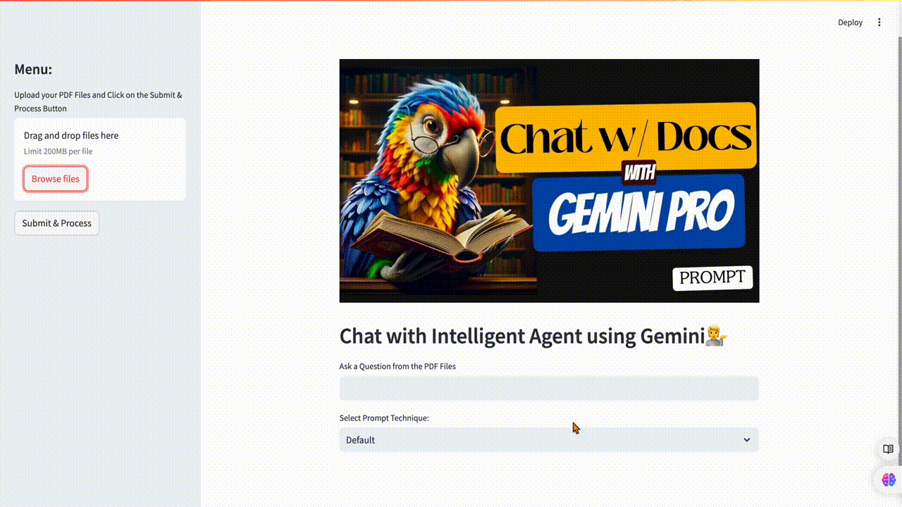
Deployment Showcase

Slide 19
Challenges
Predictive Difficulty:
Challenges in accurately predicting responses when models are focused solely on specific data types or prompts.
Privacy and Data Restrictions:
Handling sensitive data while complying with privacy regulations can limit access to relevant information and impact model performance.
Integration Complexities:
Integrating prompt techniques and models with existing systems can be complex and time-consuming.
Limited Data Availability:
Insufficient historical data or specific domain information can restrict the effectiveness and accuracy of prompt- based models.
External Factors:
Unexpected changes or external influences (e.g., shifts in domain-specific data, new research developments) could affect model accuracy and prompt responses.

Slide 20
Future Scopes
Enhanced Prompt Techniques:
Continuously improve prompt techniques by integrating advanced methods.
Incorporate factors like prompt diversity, context relevance, and user interaction.
Model Optimization:
Refine model performance by incorporating feedback and adjusting parameters.
Consider additional data sources and domain-specific contexts for enhanced accuracy.
System Integration:
Collaborate with developers to optimize the integration of prompt techniques within the Lang Chain framework.
Streamline processes for real-time updates and efficient prompt handling.
User Experience Enhancement:
Utilize feedback to predict and address user needs.
Optimize interaction strategies and prompt effectiveness based on user insights.

